Slide 1


ION - Hackathon 2020
AiZen – AI Stratification Engine
November 2020

Slide 2
Agenda
01 | Details of the team [Name, Designation, Practice Area]
02 | Brief explanation of idea & implementation
03 | Technologies used
05 | Support required, if any
06 | Assurance on completion of the idea implementation before the HACKATHON deadlines
07 | Q & A

Slide 3

Detail of Team

Slide 4
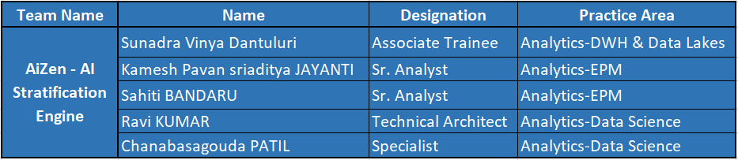
Team - AiZen

Slide 5

Brief explanation of idea & implementation

Slide 6



AiZen Capabilities
AiZen- Interface
Allow secure and reliable platform to perform Data Profiling.
Feature like Training the Classification and Regression Model with smooth UI with great user experience.
Full control to the user regarding feature selection
Application Servers
Allow developer to build easy, reliable application server.
Have capability to scale up using nginx and allow parallel processing.
Data Science
Make data clean, compatible, comparable & reliable, even when it comes from a wide range of unrelated sources
Ensure data is ready for supervised learning and model engineering.

Slide 7
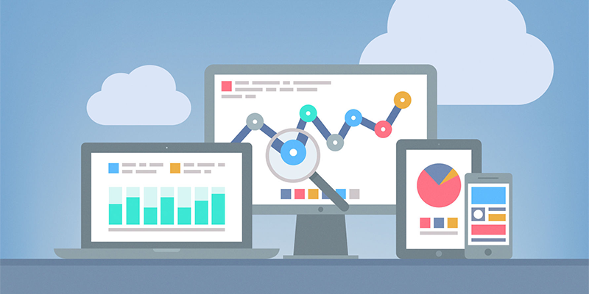
AiZen - Architecture
Web Application
API with Flask
Data Science

Slide 8


















Industry Verticals
Industry Focus
Service Portfolio
FOODTECH
HITECH
LOGISTICS
RETAIL
ENTERPRISE SOLUTIONS
IT ADVISORY
UTILITIES
TELECOM
OIL & GAS
MAUFACTURING
EMERGING
TECHNOLOGIES
ITSM
SOLUTIONS
MEDIA
ENTERTAINMENT
FINANCIAL
TRANSPORT
IT CONSULTING & STAFFING
HARDWARE
RESELLER

Slide 9
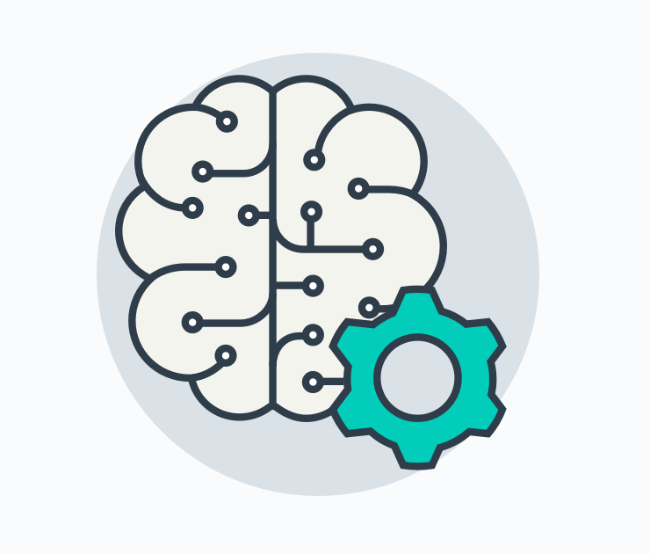
Technologies
Used

Slide 10
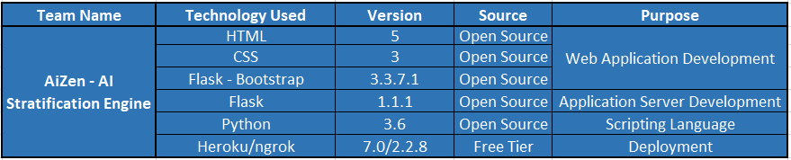
Technologies Used

Slide 11

Support
required

Slide 12
Support Required

Slide 13

Assurance of
Completion

Slide 14
Document to track the Development

Slide 15

Q & A

Slide 16


AiZen

